Slide 1




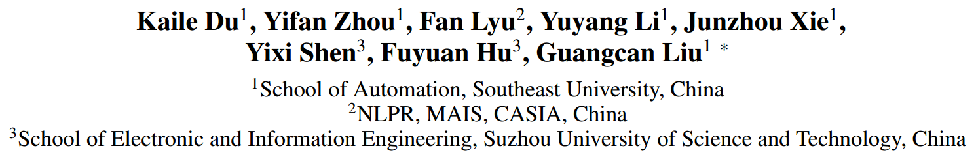



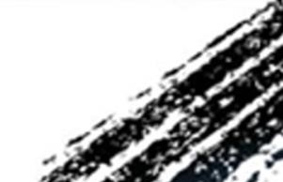

ATAI
Advanced Techniqueof Artificial Intelligence
ATAI
ChongqingUniversity _{AdvancedTechniqueof}
of Technology Artificial Intelligence
Chongqing University of
Technology
Chongqing University ^{ATAI}
_{of Technology} Advanced Techniqueof
Artificial Intelligence
Chongqing University of Technology
Chongqing University of Technology
  Rebalancing Multi-Label Class-Incremental Learning
Code: None
2025.4.28•ChongQing
—— AAAI 2025
Reported by Shunan Yin
1

Slide 2

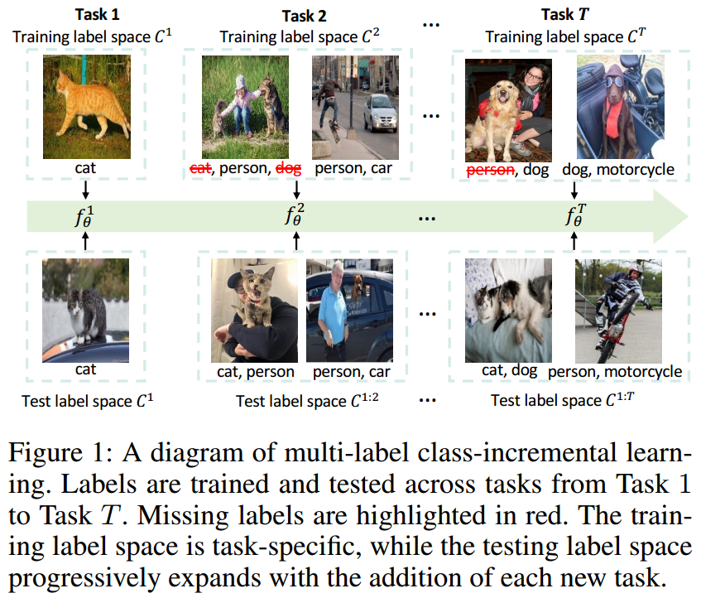
ATAI
AdvancedTechniqueof
Artificial Intelligence
ATAI
ChongqingUniversity _{AdvancedTechniqueof}
of Technology Artificial Intelligence
ChongqingUniversity of Technology
Motivation
i) While numerous methods have been developed for SLCIL, there has been limited exploration into the more practical domain of multi-label class-incremental learning.
ii) Most MLCIL methods focus on designing new network architectures to fit the PL setting, ignoring the positive-negative imbalance issue.

Slide 3

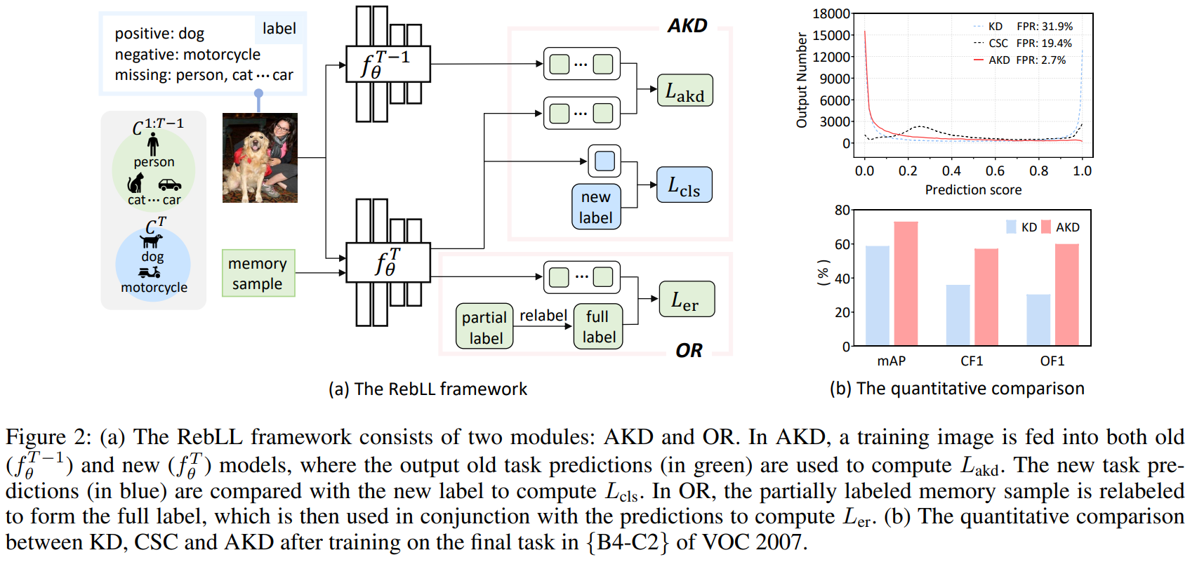
ChongqingUniversity of Technology
ATAI
AdvancedTechniqueof
Artificial Intelligence
ATAI
ChongqingUniversity _{AdvancedTechniqueof}
of Technology Artificial Intelligence
Overview

Slide 4
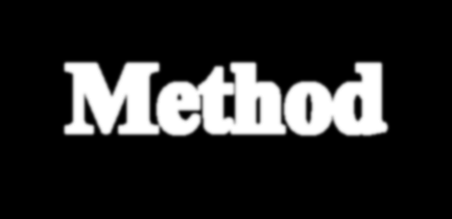

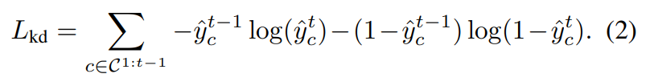
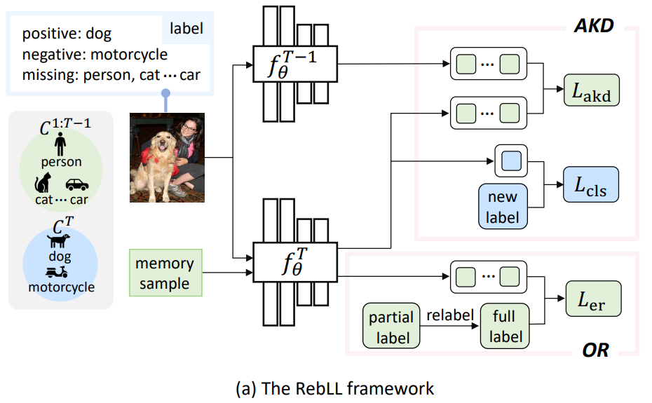
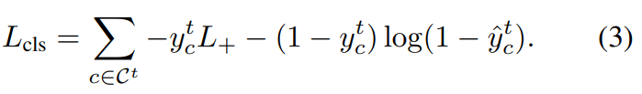

ChongqingUniversity of Technology
Method
ATAI
AdvancedTechniqueof
Artificial Intelligence
ATAI
ChongqingUniversity _{AdvancedTechniqueof}
of Technology Artificial Intelligence

Slide 5

ChongqingUniversity of Technology
Method
ATAI
AdvancedTechniqueof
Artificial Intelligence
ATAI
ChongqingUniversity _{AdvancedTechniqueof}
of Technology Artificial Intelligence

Slide 6

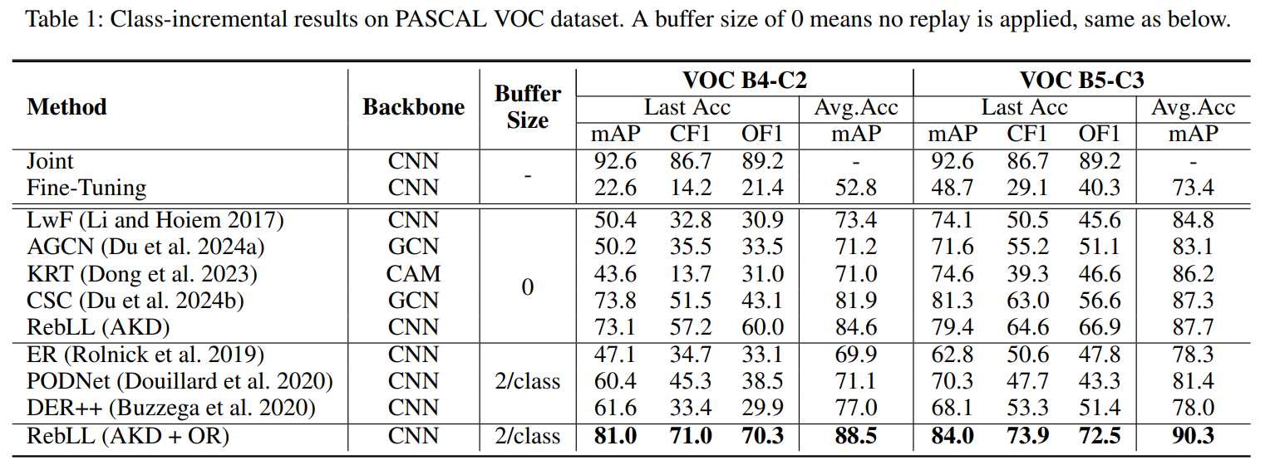
ATAI
AdvancedTechniqueof
Artificial Intelligence
ATAI
ChongqingUniversity _{AdvancedTechniqueof}
of Technology Artificial Intelligence
ChongqingUniversity of Technology
Experiments

Slide 7
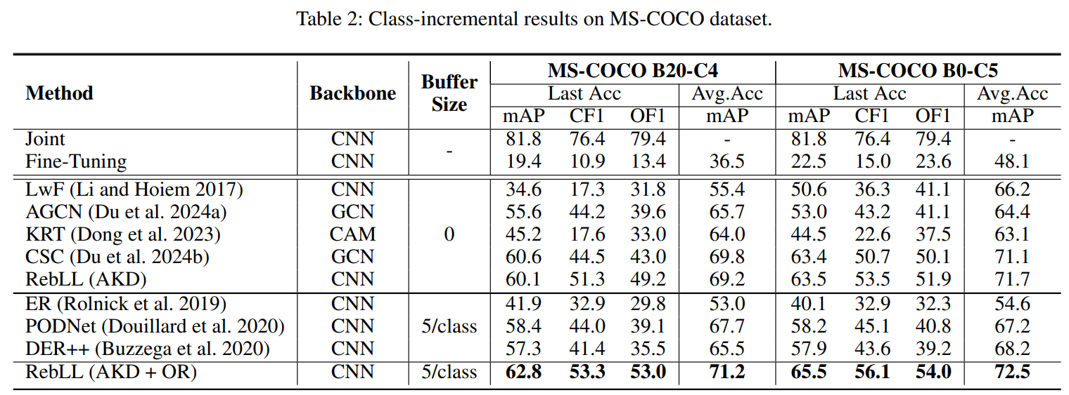
ATAI
AdvancedTechniqueof
Artificial Intelligence
ATAI
ChongqingUniversity _{AdvancedTechniqueof}
of Technology Artificial Intelligence
ChongqingUniversity of Technology
Experiments

Slide 8
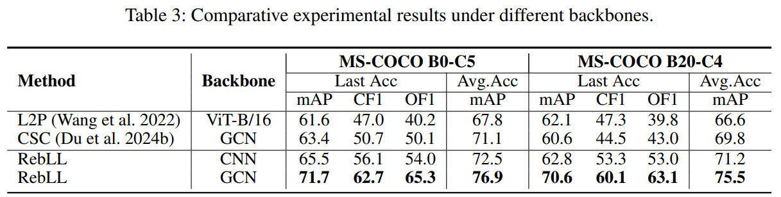
ATAI
AdvancedTechniqueof
Artificial Intelligence
ATAI
ChongqingUniversity _{AdvancedTechniqueof}
of Technology Artificial Intelligence
ChongqingUniversity of Technology
Experiments

Slide 9
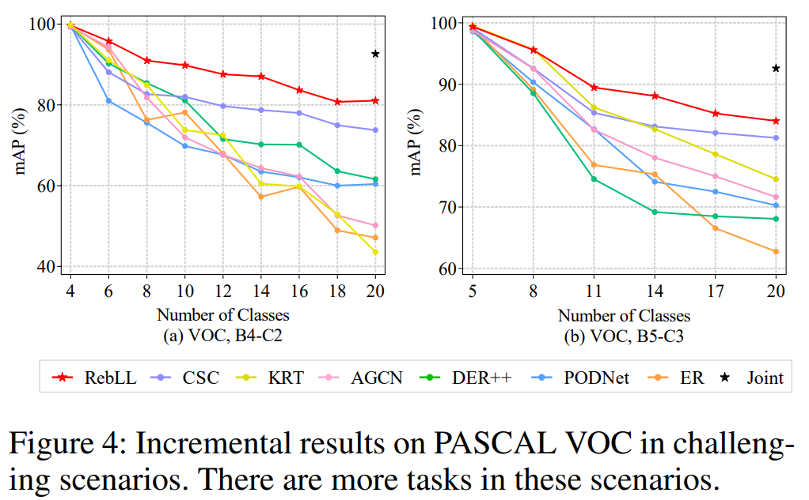
ATAI
AdvancedTechniqueof
Artificial Intelligence
ATAI
ChongqingUniversity _{AdvancedTechniqueof}
of Technology Artificial Intelligence
ChongqingUniversity of Technology
Experiments

Slide 10
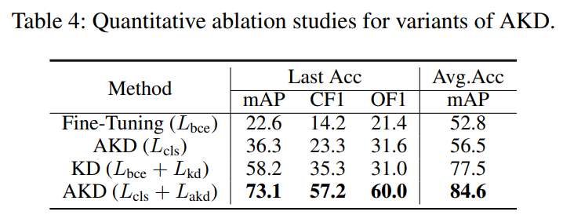
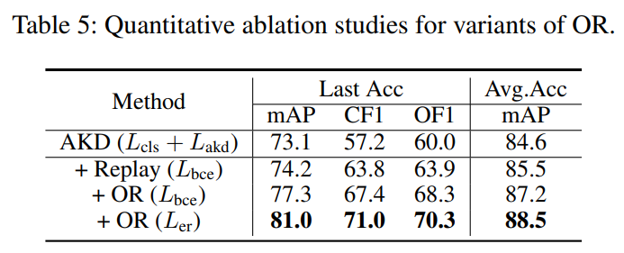
ATAI
AdvancedTechniqueof
Artificial Intelligence
ATAI
ChongqingUniversity _{AdvancedTechniqueof}
of Technology Artificial Intelligence
ChongqingUniversity of Technology
Experiments

Slide 11
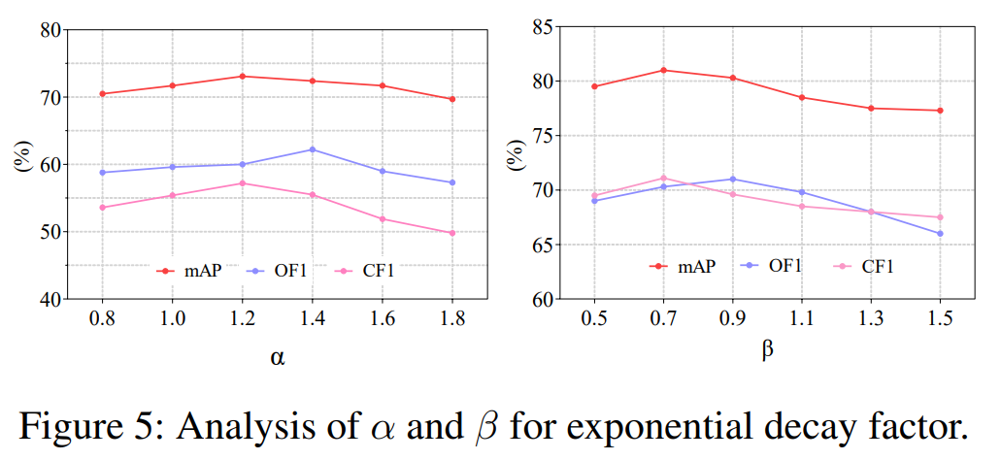
ATAI
AdvancedTechniqueof
Artificial Intelligence
ATAI
ChongqingUniversity _{AdvancedTechniqueof}
of Technology Artificial Intelligence
ChongqingUniversity of Technology
Experiments

Slide 12
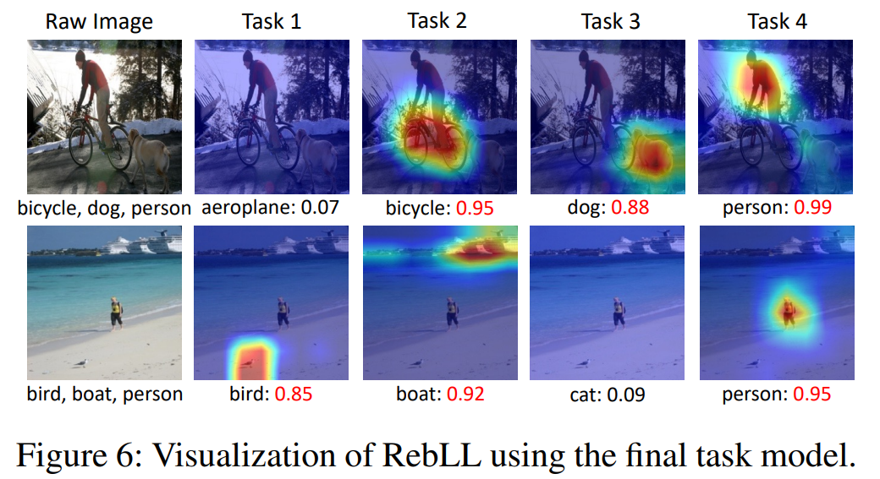
Experiments
ATAI
AdvancedTechniqueof
Artificial Intelligence
ATAI
ChongqingUniversity _{AdvancedTechniqueof}
of Technology Artificial Intelligence
ChongqingUniversity of Technology

Slide 13
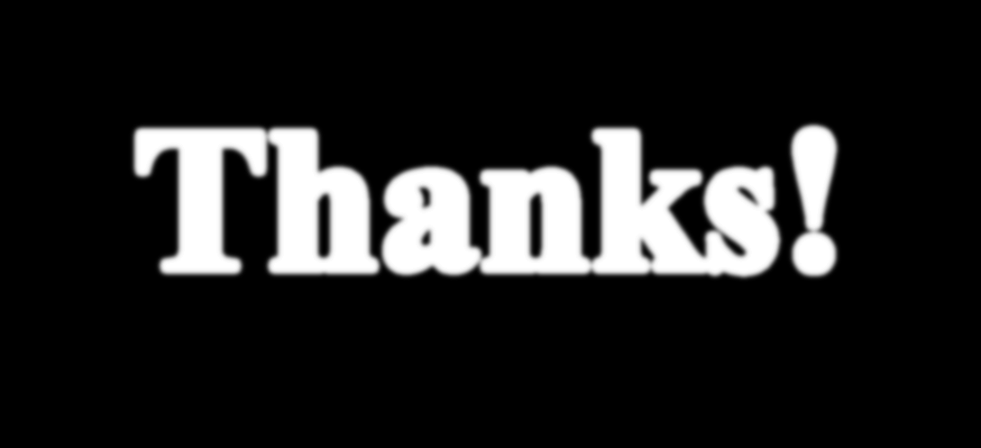

ChongqingUniversity of Technology
ATAI
AdvancedTechniqueof
Artificial Intelligence
ATAI
ChongqingUniversity _{AdvancedTechniqueof}
of Technology Artificial Intelligence
Thanks!

